Slide 1
When Differential Privacy meets Explainability
刘文炎

Slide 2
Transparency and privacy
Black-box algorithms
Algorithmic transparency
Explanation dataset
Model-agnostic methods often use a dataset labeled by the black-box model to generate model explanations
A subset of the training data, or sampled from the same distribution
Data privacy risks
Model explanations can leak information about the training data and the explanation data used to generate them

Slide 3
Model Explanations with Differential Privacy
Neel Patel, Reza Shokri, Yair Zick
National University of Singapore

Slide 4
Model Explanations that Protect Data Privacy
Provably sound: similar to standard model explanations
Model-agnostic: adapted to any feature based explanation method
Differentially private:
A baseline interactive mechanism that outputs feature-based model explanations, while guaranteeing differential privacy for each query
An adaptive differential privacy mechanism for model explanations
An enhanced adaptive algorithm
A non-interactive differential privacy algorithm

Slide 5
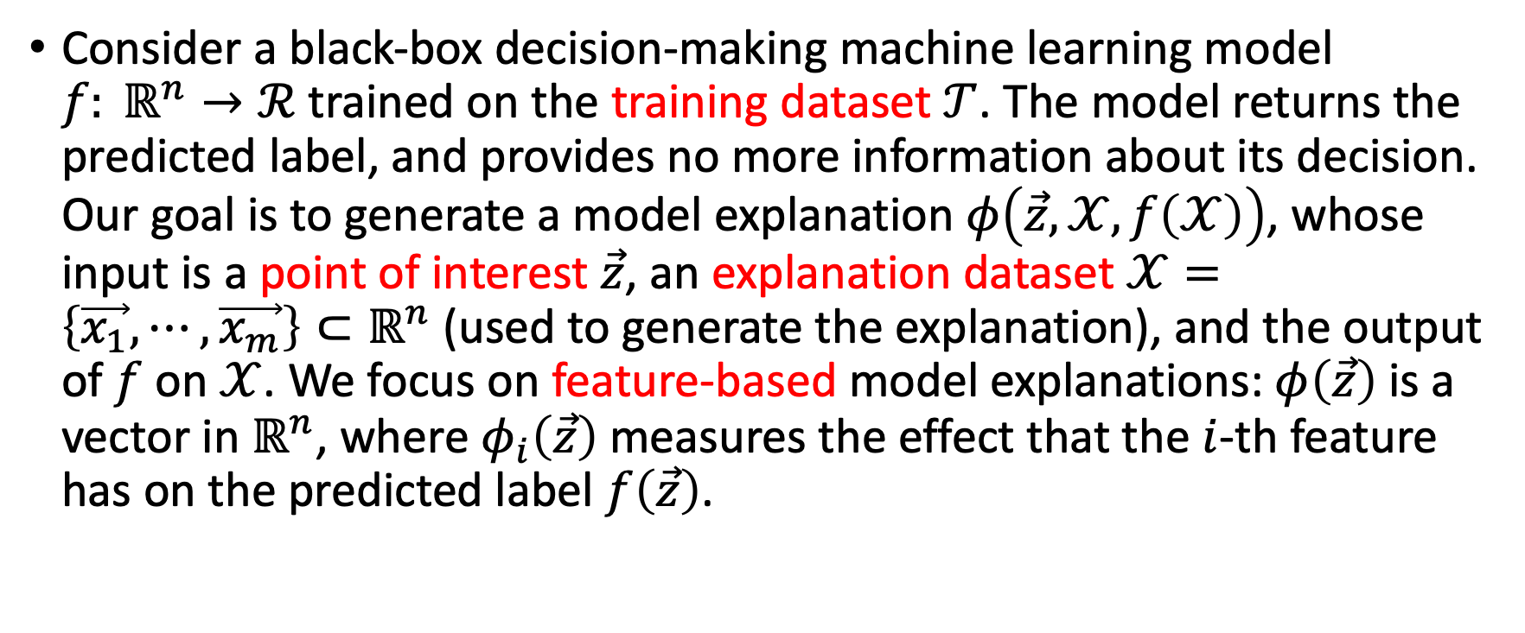
Problem Statement
Consider a black-box decision-making machine learning model $f: ℝ^{n}→ℛ$ trained on the training dataset $𝒯$. The model returns the predicted label, and provides no more information about its decision. Our goal is to generate a model explanation $φ\left(\vec{z}, 𝒳, f\left(𝒳\right)\right)$, whose input is a point of interest $\vec{z}$, an explanation dataset $𝒳=\left\{\vec{x_{1}}, ⋯,\vec{x_{m}}\right\}⊂ℝ^{n}$ (used to generate the explanation), and the output of $f$ on $𝒳$. We focus on feature-based model explanations: $φ\left(\vec{z}\right)$is a vector in $ℝ^{n}$, where $φ_{i}\left(\vec{z}\right)$measures the effect that the $i$-th feature has on the predicted label $f\left(\vec{z}\right)$.

Slide 6
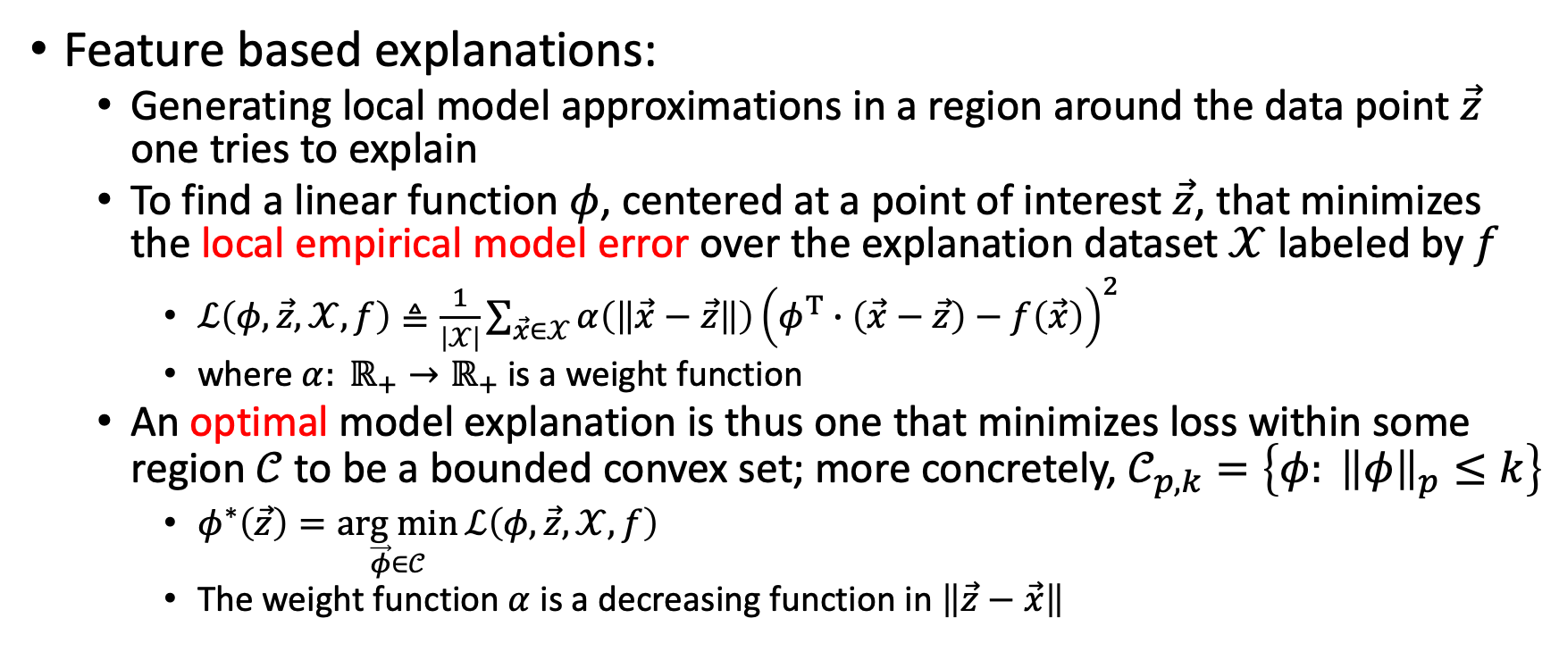
Problem Statement · Model Explanations
Feature based explanations:
Generating local model approximations in a region around the data point $\vec{z}$ one tries to explain
To find a linear function $φ$, centered at a point of interest $\vec{z}$, that minimizes the local empirical model error over the explanation dataset $𝒳$ labeled by $f$
$ℒ\left(φ,\vec{z},𝒳, f\right)≜\frac{1}{\left|𝒳\right|}\sum_{\vec{x}∈𝒳}{α\left(\left\|\vec{x}−\vec{z}\right\|\right){\left(φ^{T}∙\left(\vec{x}−\vec{z}\right)−f\left(\vec{x}\right)\right)}^{2}}$
where $α: ℝ_{+}→ℝ_{+}$ is a weight function
An optimal model explanation is thus one that minimizes loss within some region $𝒞$ to be a bounded convex set; more concretely, $𝒞_{p, k}=\left\{φ: {\left\|φ\right\|}_{p}≤k\right\}$
$φ^{∗}\left(\vec{z}\right)=\underset{\vec{φ}∈𝒞}{arg min}{ℒ\left(φ,\vec{z},𝒳, f\right)}$
The weight function $α$ is a decreasing function in $\left\|\vec{z}−\vec{x}\right\|$

Slide 7
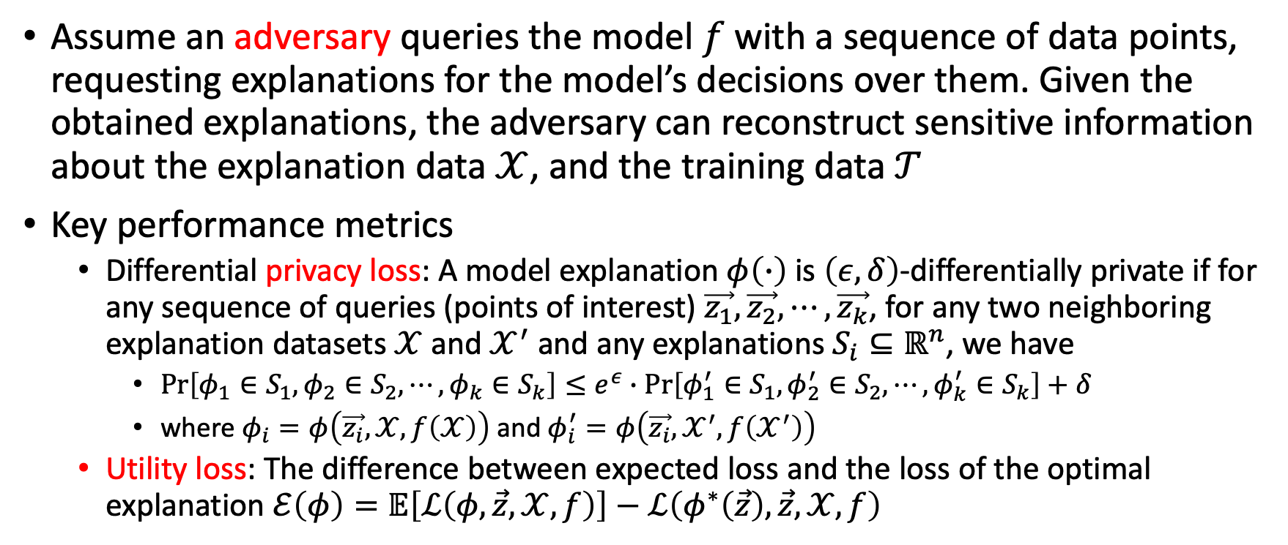
Problem Statement · Evaluation Metrics
Assume an adversary queries the model $f$ with a sequence of data points, requesting explanations for the model’s decisions over them. Given the obtained explanations, the adversary can reconstruct sensitive information about the explanation data $𝒳$, and the training data $𝒯$
Key performance metrics
Differential privacy loss: A model explanation $φ\left(∙\right)$ is $\left(ε, δ\right)$-differentially private if for any sequence of queries (points of interest) $\vec{z_{1}},\vec{z_{2}}, ⋯,\vec{z_{k}}$, for any two neighboring explanation datasets $𝒳$ and $𝒳^{′}$ and any explanations $S_{i}⊆ℝ^{n}$, we have
$Pr\left[φ_{1}∈S_{1},φ_{2}∈S_{2}, ⋯,φ_{k}∈S_{k}\right]≤e^{ε}∙Pr\left[φ_{1}^{′}∈S_{1},φ_{2}^{′}∈S_{2}, ⋯,φ_{k}^{′}∈S_{k}\right]+δ$
where $φ_{i}=φ\left(\vec{z_{i}},𝒳, f\left(𝒳\right)\right)$ and $φ_{i}^{′}=φ\left(\vec{z_{i}},𝒳^{′}, f\left(𝒳^{′}\right)\right)$
Utility loss: The difference between expected loss and the loss of the optimal explanation $ℰ\left(φ\right)=𝔼\left[ℒ\left(φ,\vec{z},𝒳, f\right)\right]−ℒ\left(φ^{∗}\left(\vec{z}\right),\vec{z},𝒳, f\right)$

Slide 8
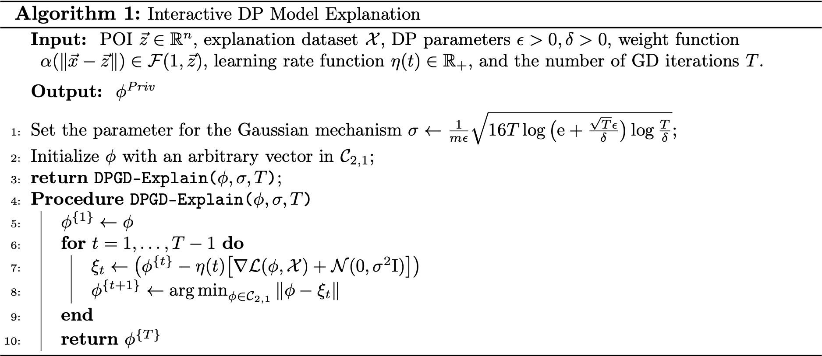
A Basic DP Mechanism for Model Explanation

Slide 9
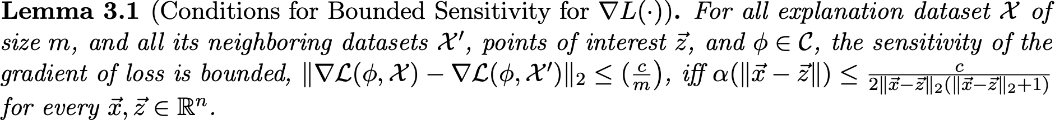
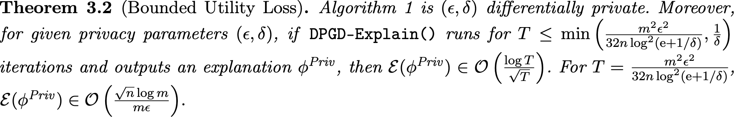
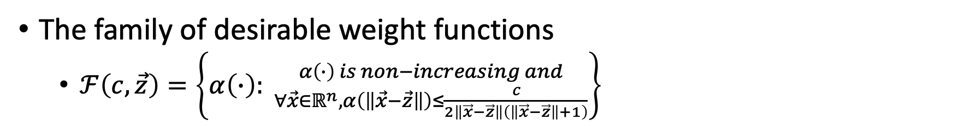
DPGD-Explain · Sensitivity of the Loss Function
The family of desirable weight functions
$ℱ\left(c,\vec{z}\right)=\left\{α\left(∙\right): {α\left(∙\right) is non−increasing and \atop ∀\vec{x}∈ℝ^{n},α\left(\left\|\vec{x}−\vec{z}\right\|\right)≤\frac{c}{2\left\|\vec{x}−\vec{z}\right\|\left(\left\|\vec{x}−\vec{z}\right\|+1\right)}}\right\}$
DPGD-Explain · Privacy and Utility Guarantees

Slide 10
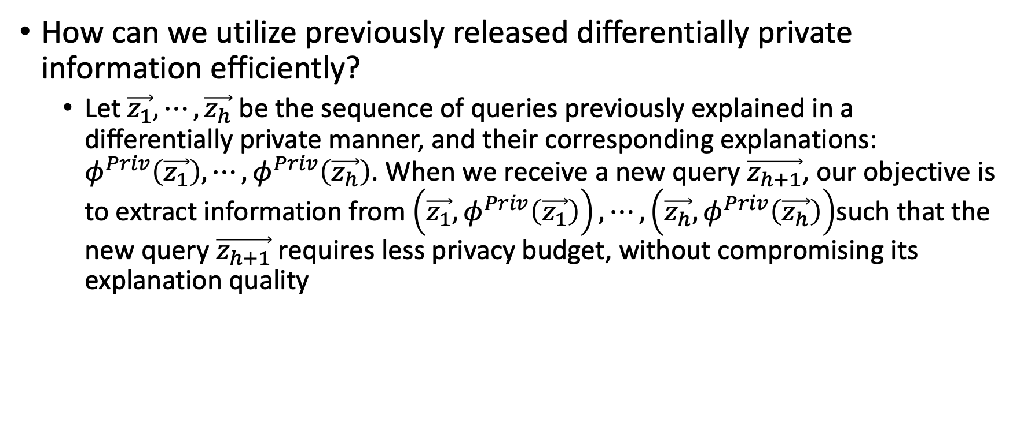
Adaptive Differential Privacy Mechanisms
How can we utilize previously released differentially private information efficiently?
Let $\vec{z_{1}}, ⋯,\vec{z_{h}}$ be the sequence of queries previously explained in a differentially private manner, and their corresponding explanations: $φ^{Priv}\left(\vec{z_{1}}\right),⋯,φ^{Priv}\left(\vec{z_{h}}\right)$. When we receive a new query $\vec{z_{h+1}}$, our objective is to extract information from $\left(\vec{z_{1}},φ^{Priv}\left(\vec{z_{1}}\right)\right), ⋯,\left(\vec{z_{h}},φ^{Priv}\left(\vec{z_{h}}\right)\right)$such that the new query $\vec{z_{h+1}}$ requires less privacy budget, without compromising its explanation quality

Slide 11
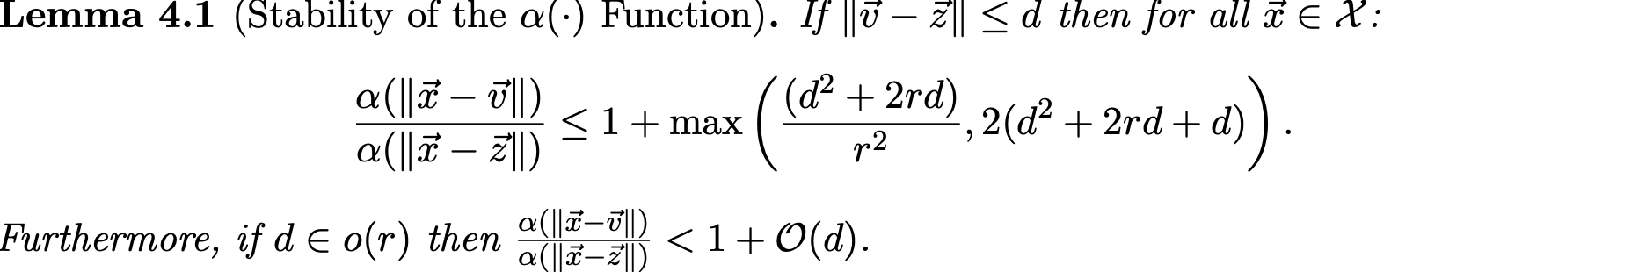
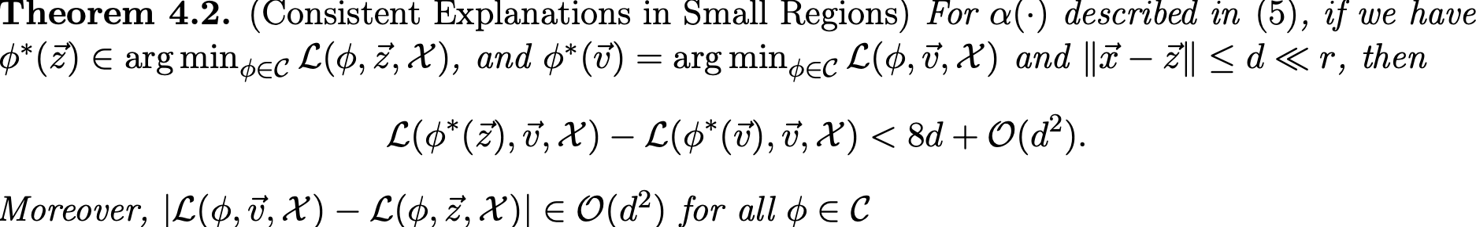
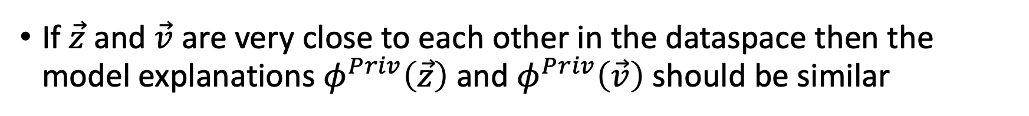
Finding similar points from prior explanation queries
If $\vec{z}$ and $\vec{v}$ are very close to each other in the dataspace then the model explanations $φ^{Priv}\left(\vec{z}\right)$ and $φ^{Priv}\left(\vec{v}\right)$ should be similar

Slide 12
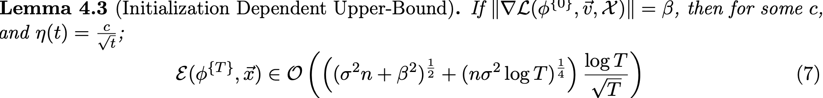
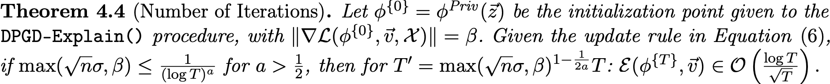
Reusing prior explanations for a better optimization

Slide 13
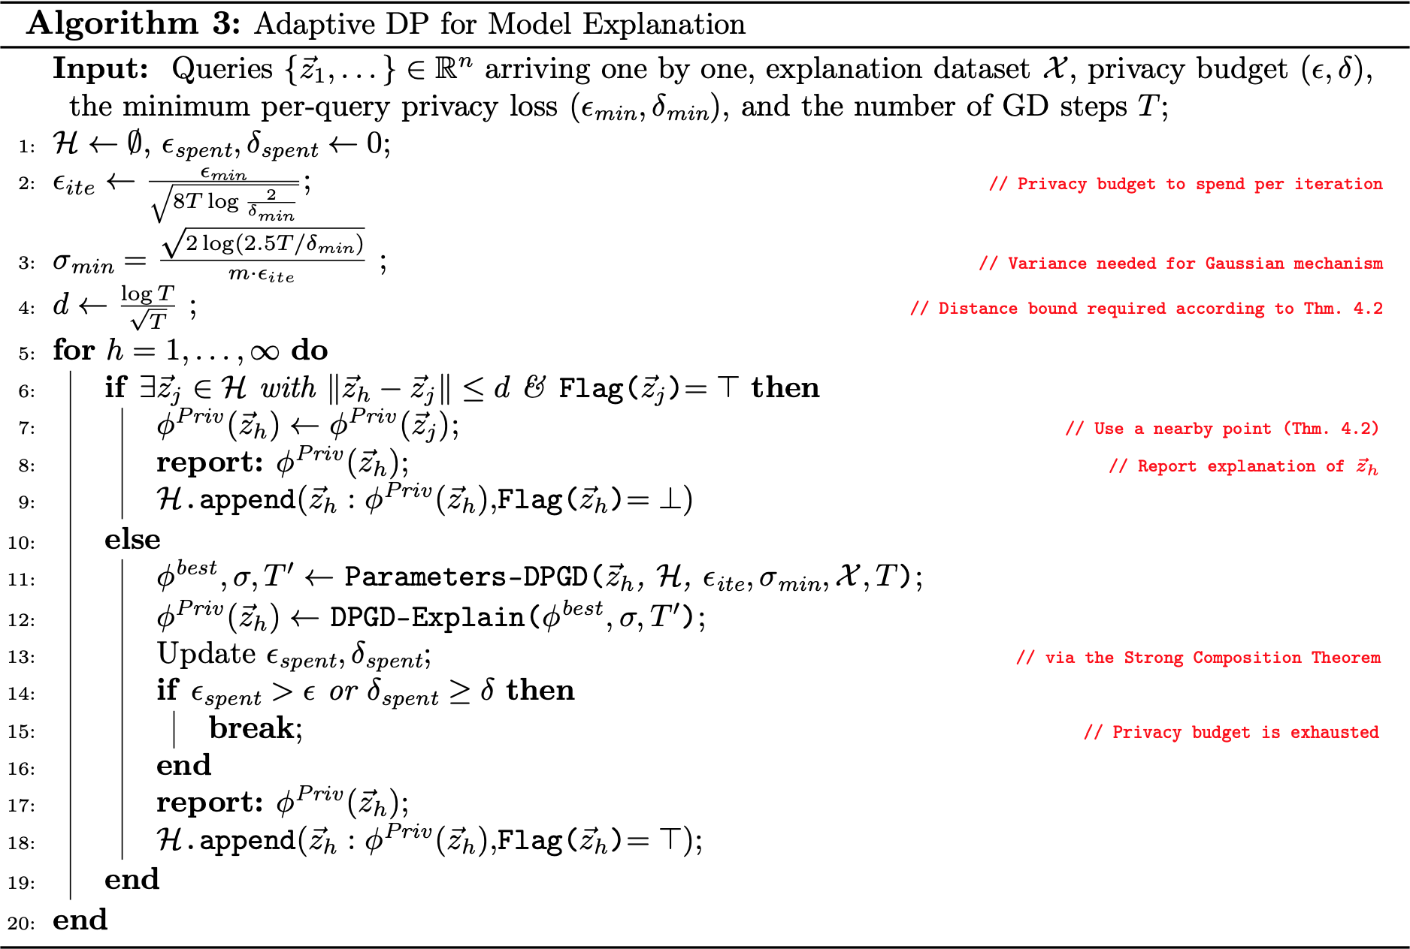

Slide 14
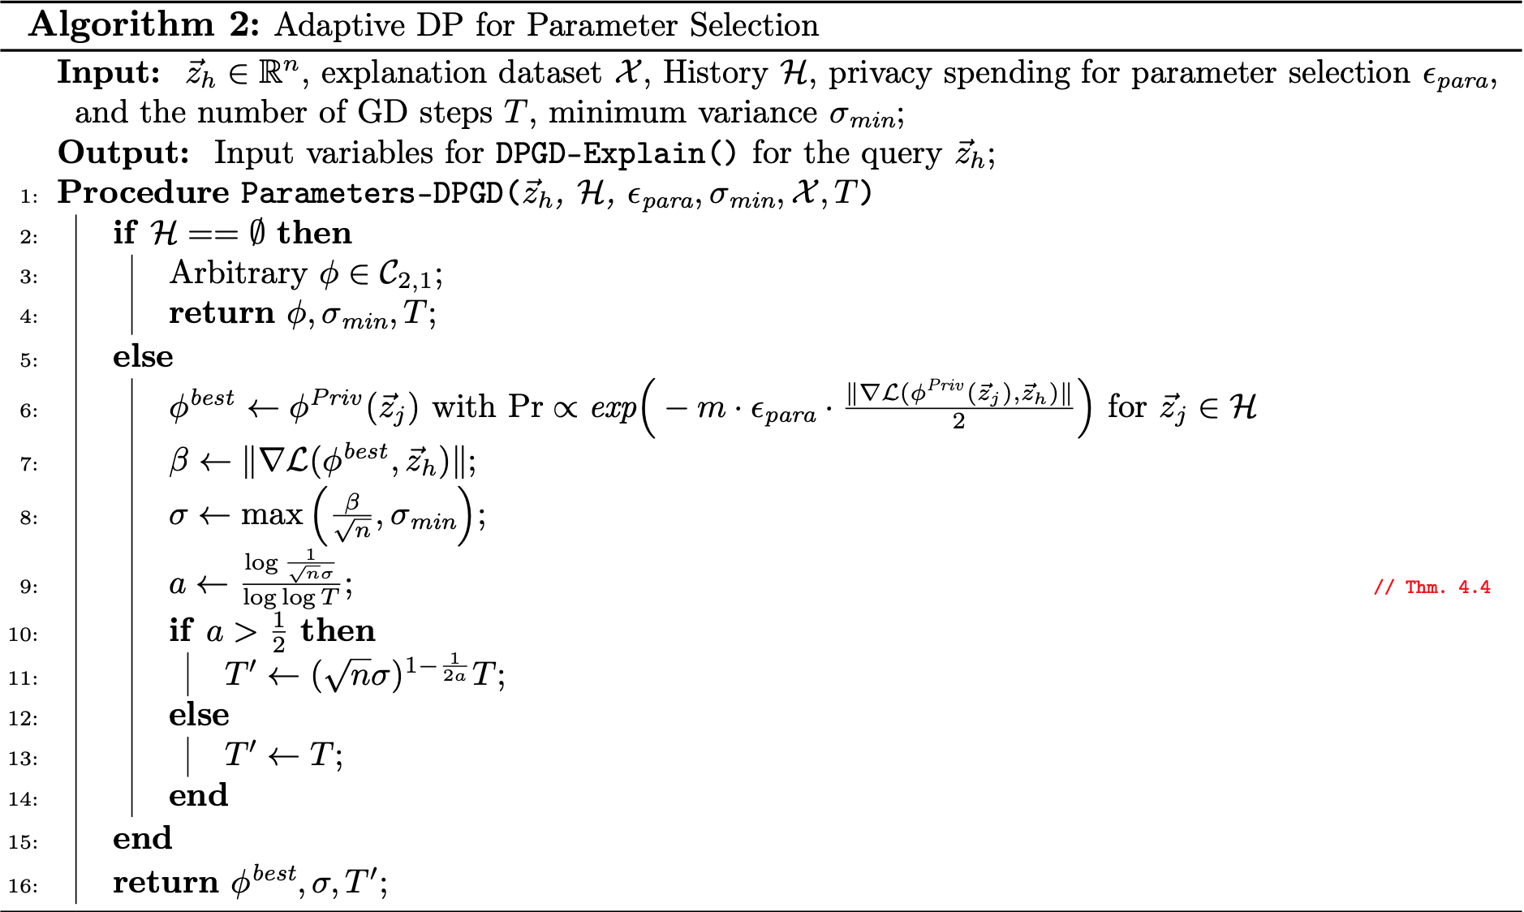

Slide 15
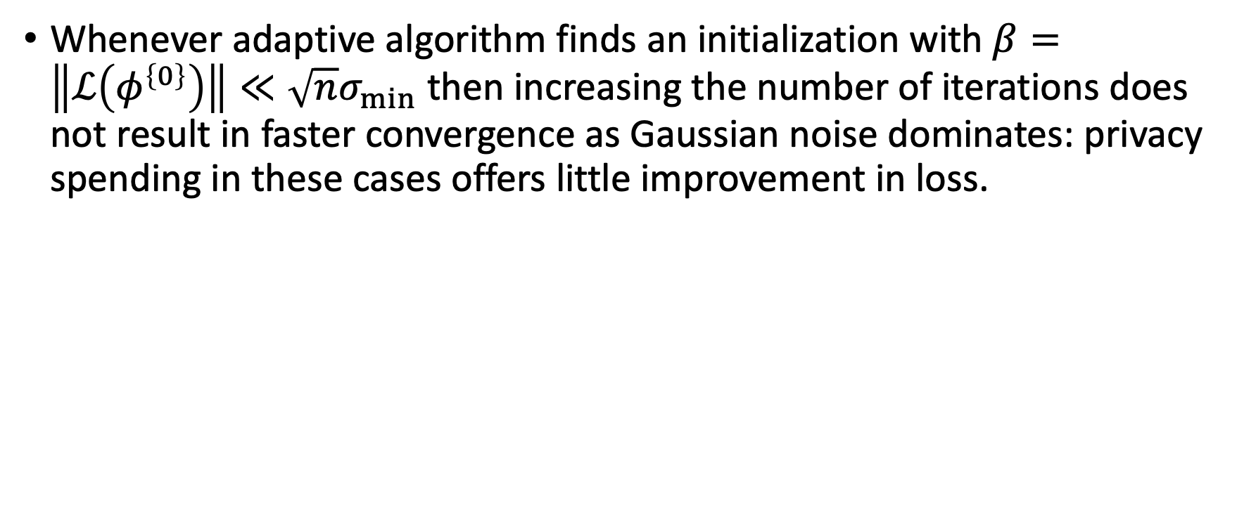
Early Termination and an Enhanced Adaptive Algorithm
Whenever adaptive algorithm finds an initialization with $β=\left\|ℒ\left(φ^{\left\{0\right\}}\right)\right\|≪\sqrt{n}σ_{min}$ then increasing the number of iterations does not result in faster convergence as Gaussian noise dominates: privacy spending in these cases offers little improvement in loss.

Slide 16
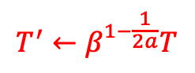
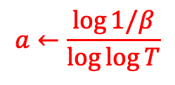
$$a←\frac{\log{1/β}}{\log{\log{T}}}$$
$$T^{′}←β^{1−\frac{1}{2a}}T$$

Slide 17
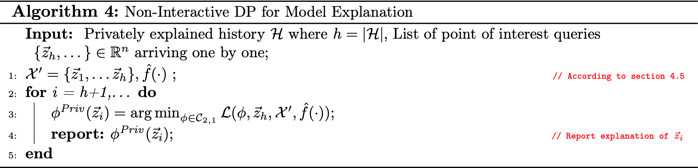
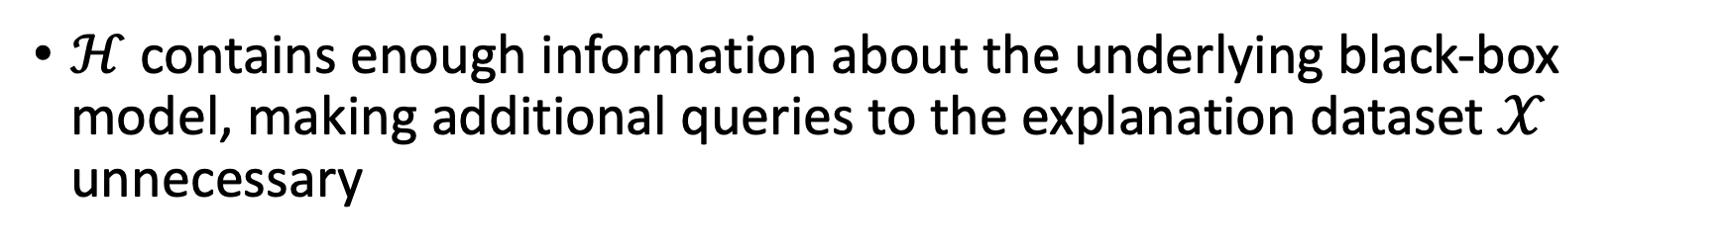
Non-Interactive DP Mechanisms for Model Explanation
$ℋ$ contains enough information about the underlying black-box model, making additional queries to the explanation dataset $𝒳$ unnecessary

Slide 18
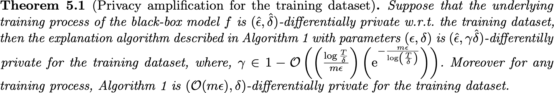
Protecting the Privacy of the Training Dataset

Slide 19
Experimental Results
ACS13: 1,494,974 records; predict income (> 50k$ vs ≤ 50k$)
IMDB/Amazon Movie Reviews (Text dataset): 8,765,568 movie reviews from the Amazon review dataset; 50,000 movie reviews from IMDB large review dataset; mapped to binary vector using the top 500 words; labeled as either a positive (+1) or a negative (−1) review
Facial expression dataset: 12,156 48×48 pixel grayscale images of faces

Slide 20
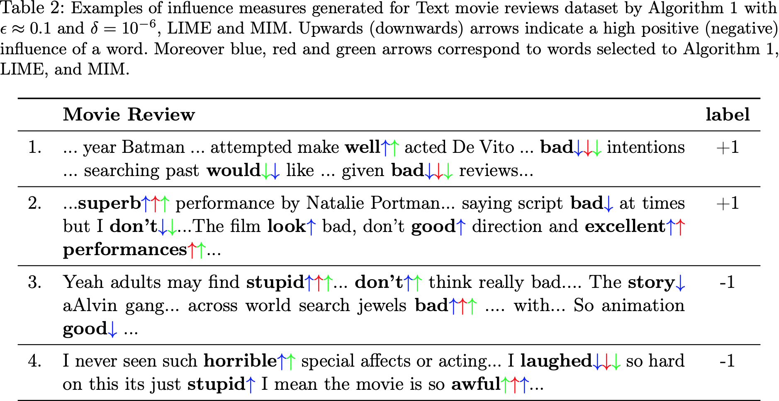
Interactive DP Model Explanation

Slide 21
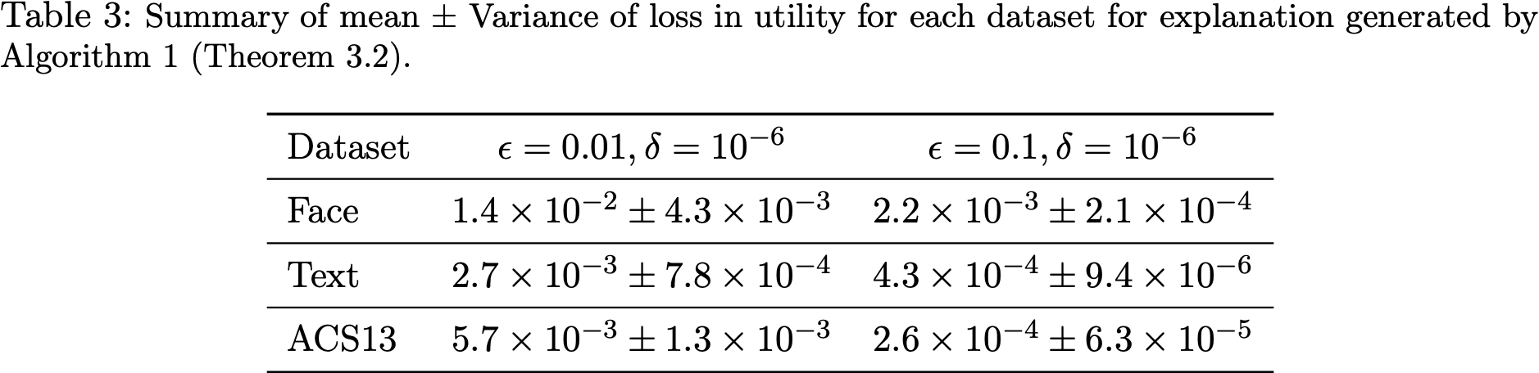
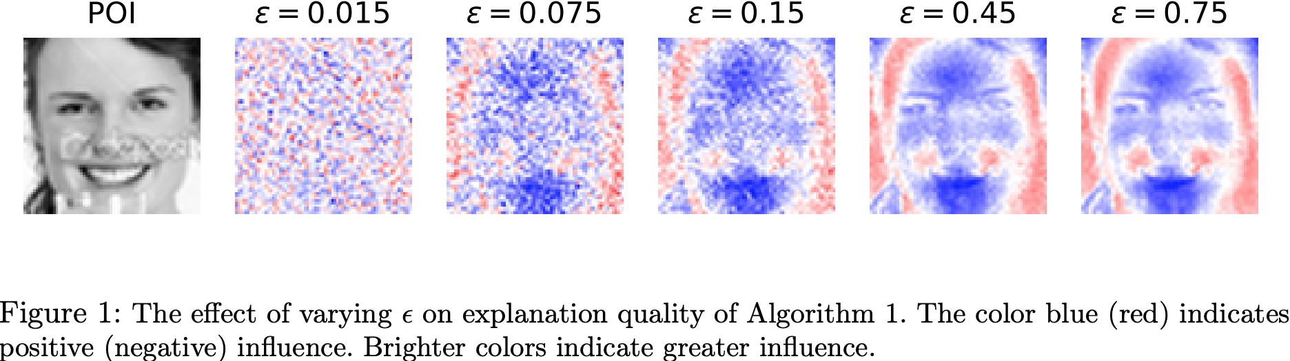
How does explanation quality degrade as we make our privacy requirements more stringent?

Slide 22
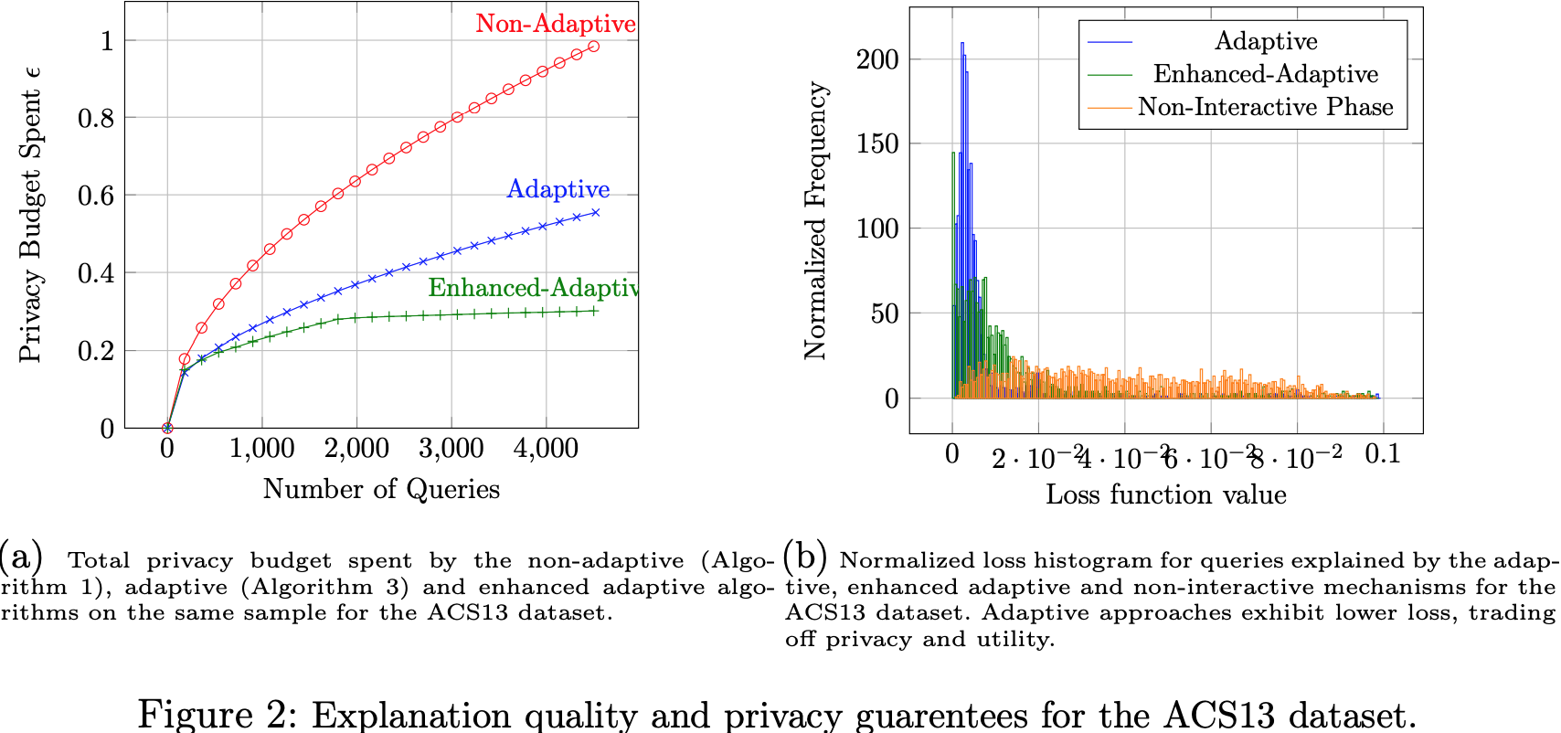
Saving the Privacy Budget via the Adaptive Approach

Slide 23
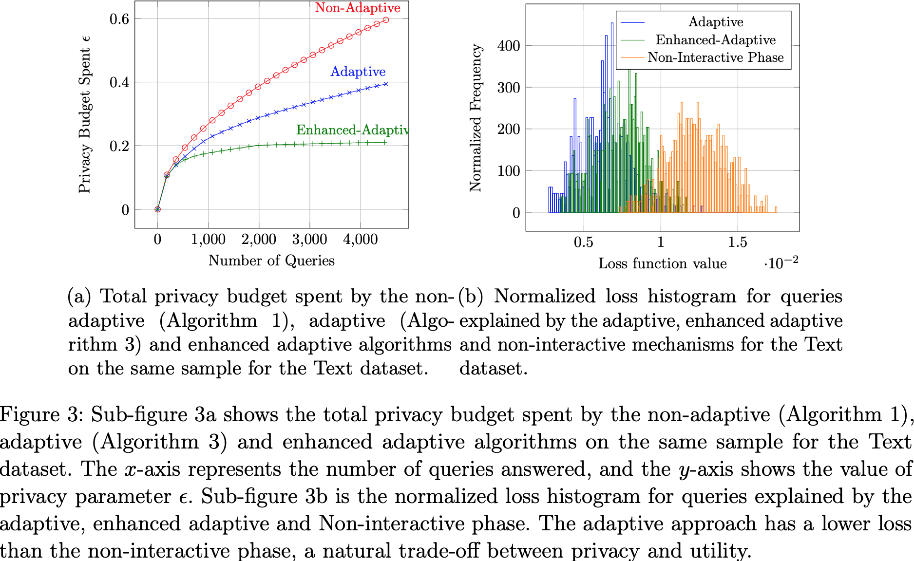

Slide 24
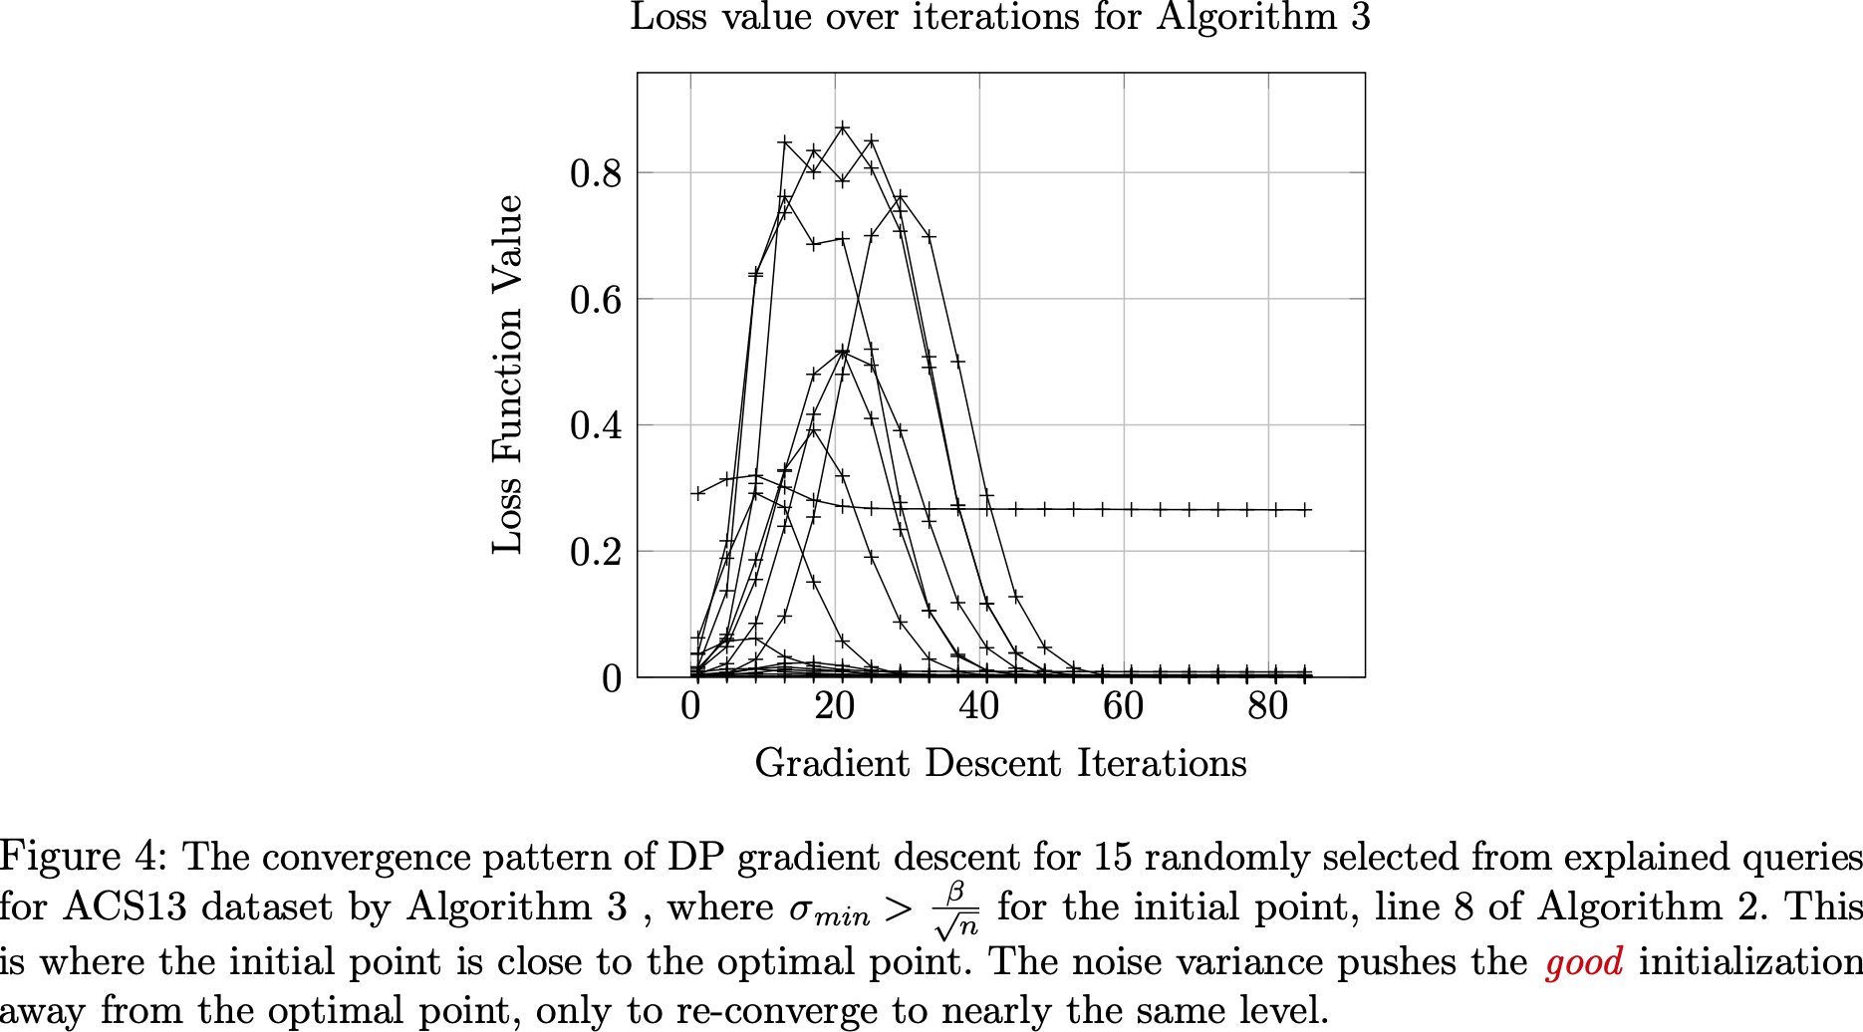

Slide 25
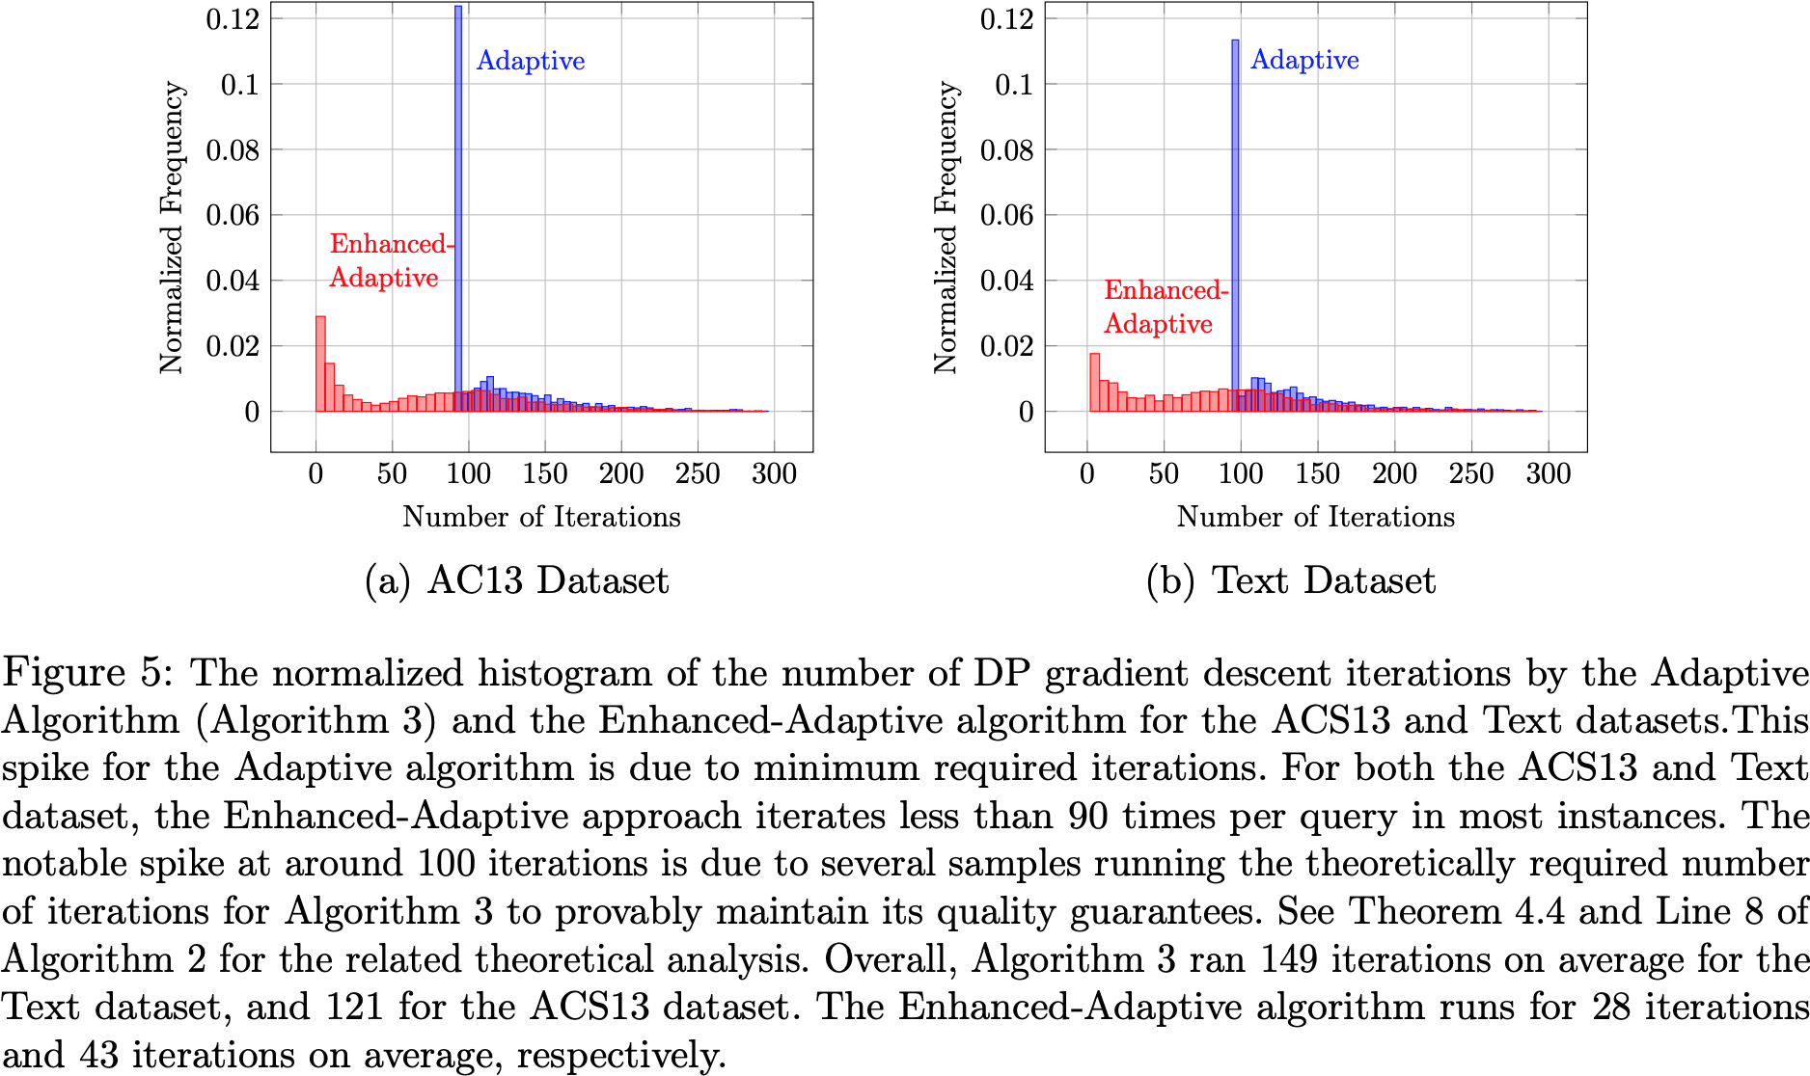

Slide 26
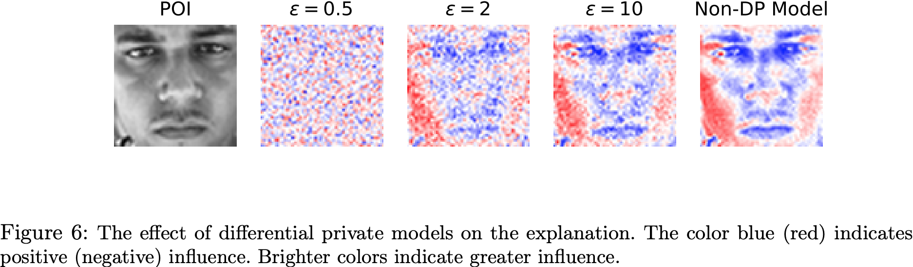
Differentially Private Explanation for Differentially Private Models

Slide 27
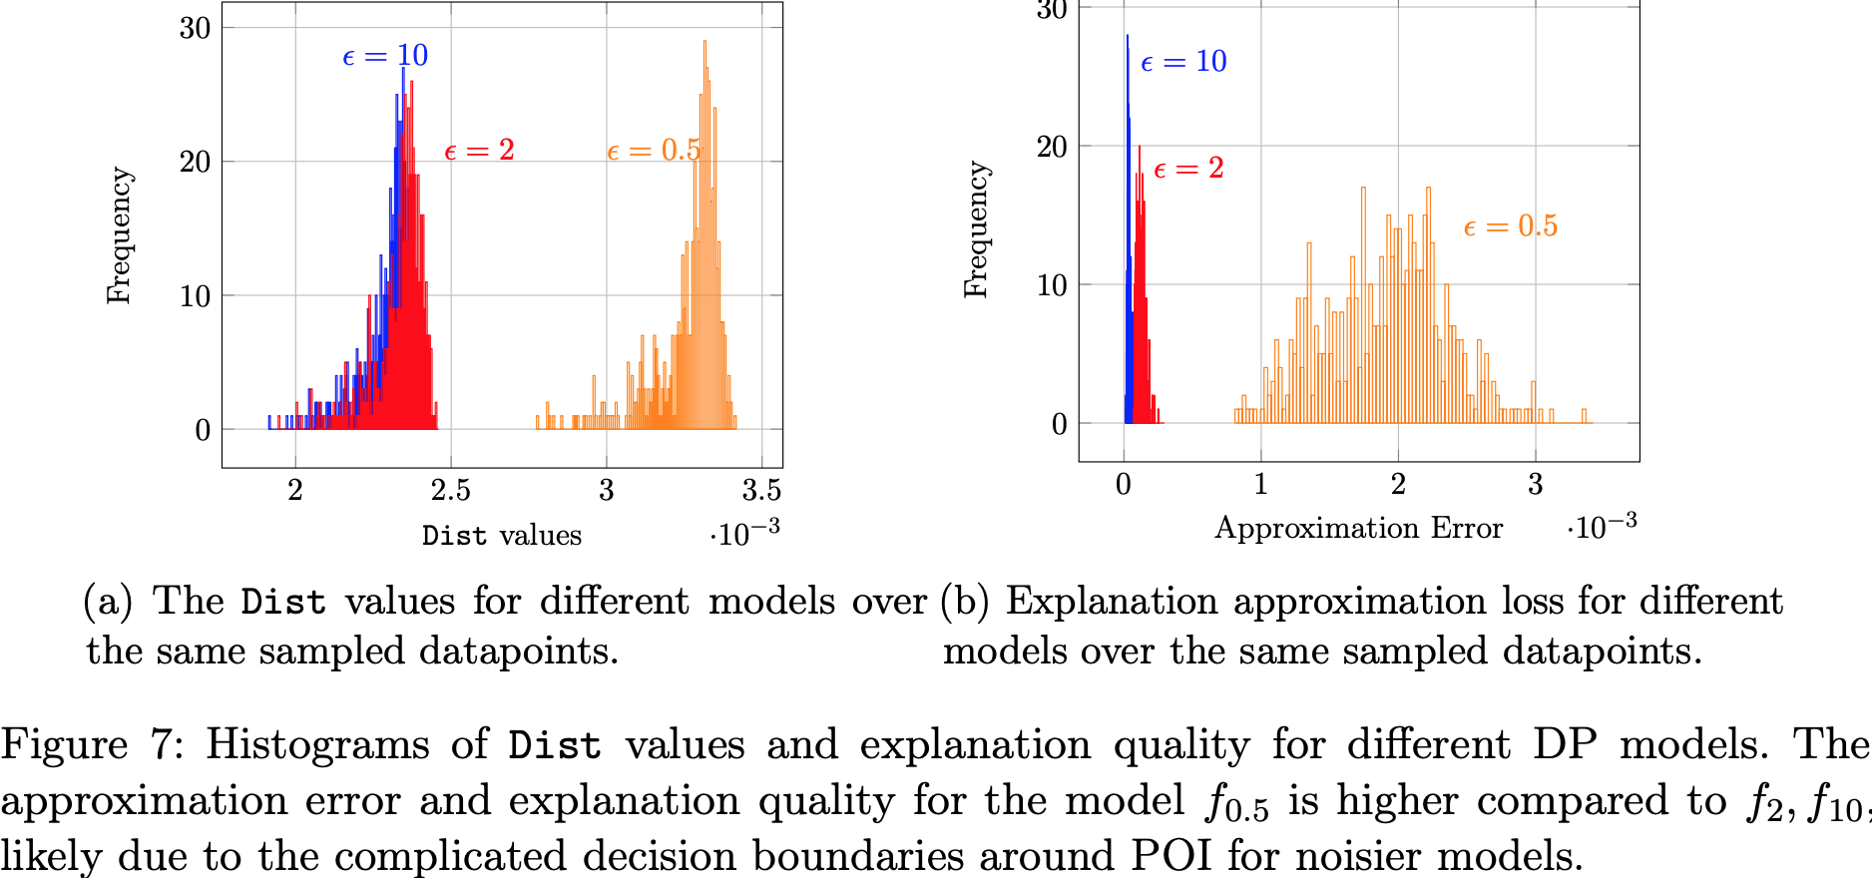

Slide 28
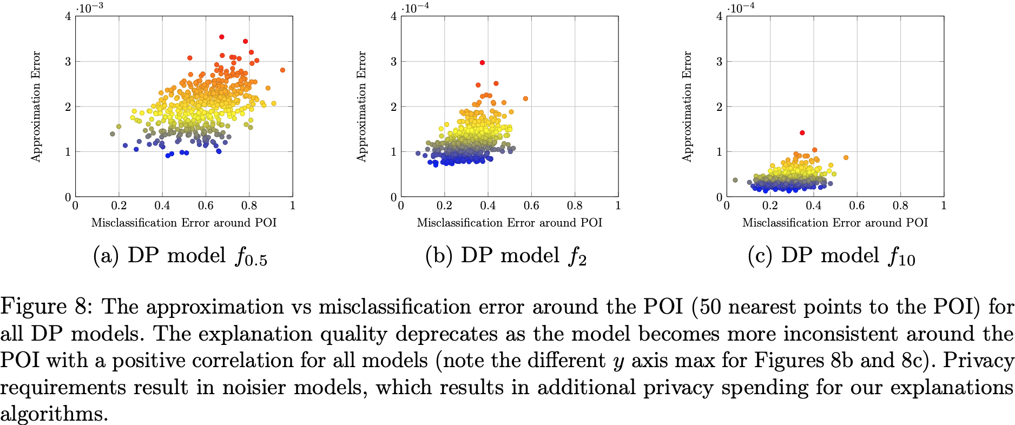

Slide 29
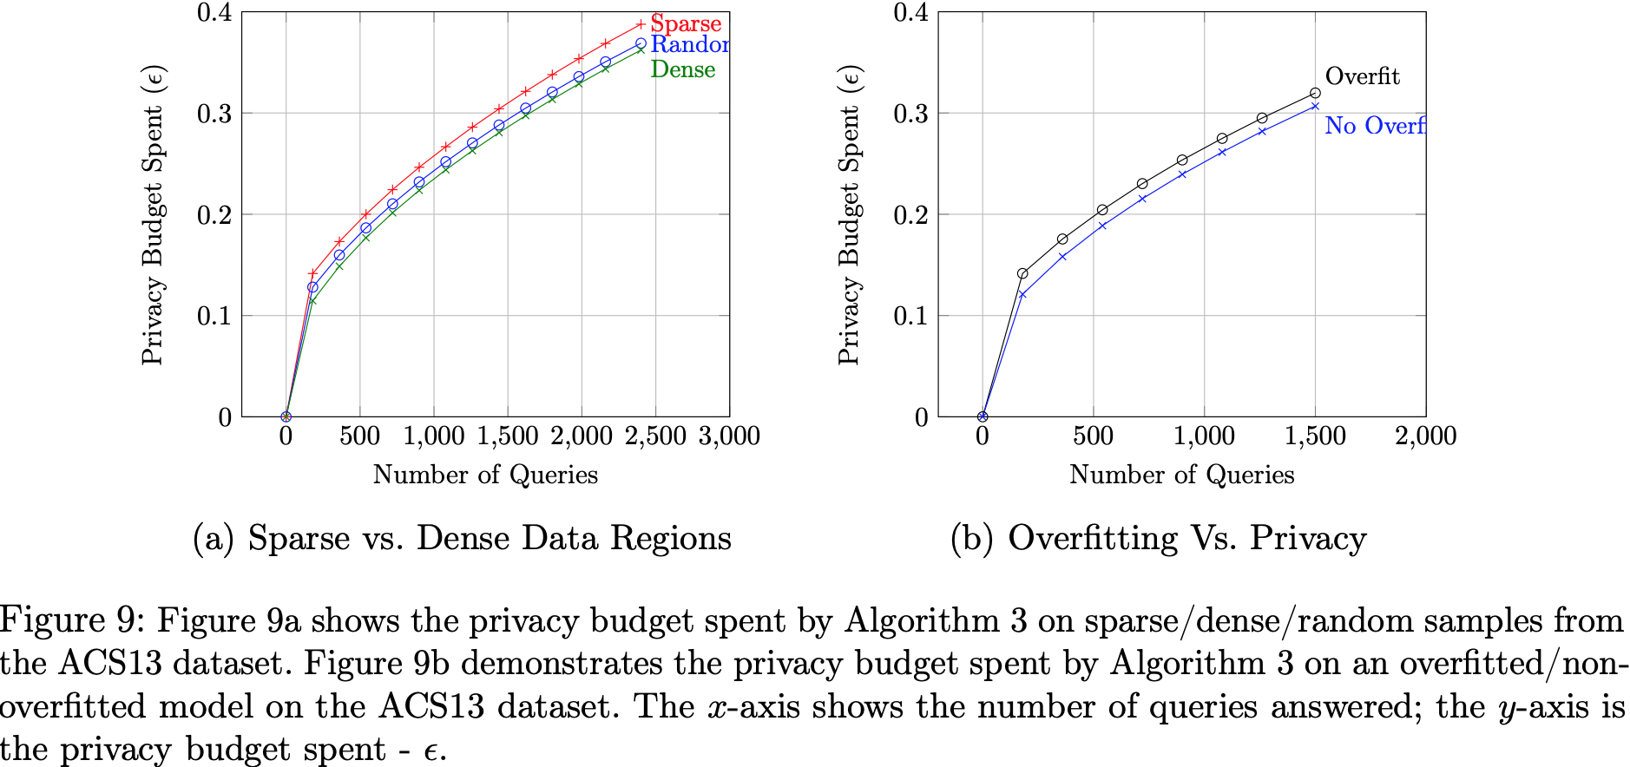
The Effect of Data Density/Overfitting

Slide 30
Broader Impact
Disparate impact:
Regions where the model overfits to the data tend to suffer more from privacy/quality tradeoffs
It is important to ensure that minority groups are not adversely affected in unacceptable ways.
It is undesirable to offer low-quality model explanations to minorities, but it is also undesirable to risk leaking their private information.

Slide 31
Conclusions
A formal framework for studying differential privacy in model explanations
Reduce the overall privacy loss on explanation data, by adaptively reusing past differentially private explanations
When approaching the optimal point, the DP gradient descent algorithm oscillates around the optimal point, spending a significant chunk of the privacy budget while obtaining only a negligible expected utility

Slide 32
When Differential Privacy Meets Interpretability: A Case Study
Rakshit Naidu, Aman Priyanshu, Aadith Kumar, Sasikanth Kotti, Haofan Wang, Fatemehsadat Mireshghallah
Manipal Institute of Technology, Carnegie Mellon University, OpenMined, University of Pennsylvania, IIT Jodhpur, University of California

Slide 33
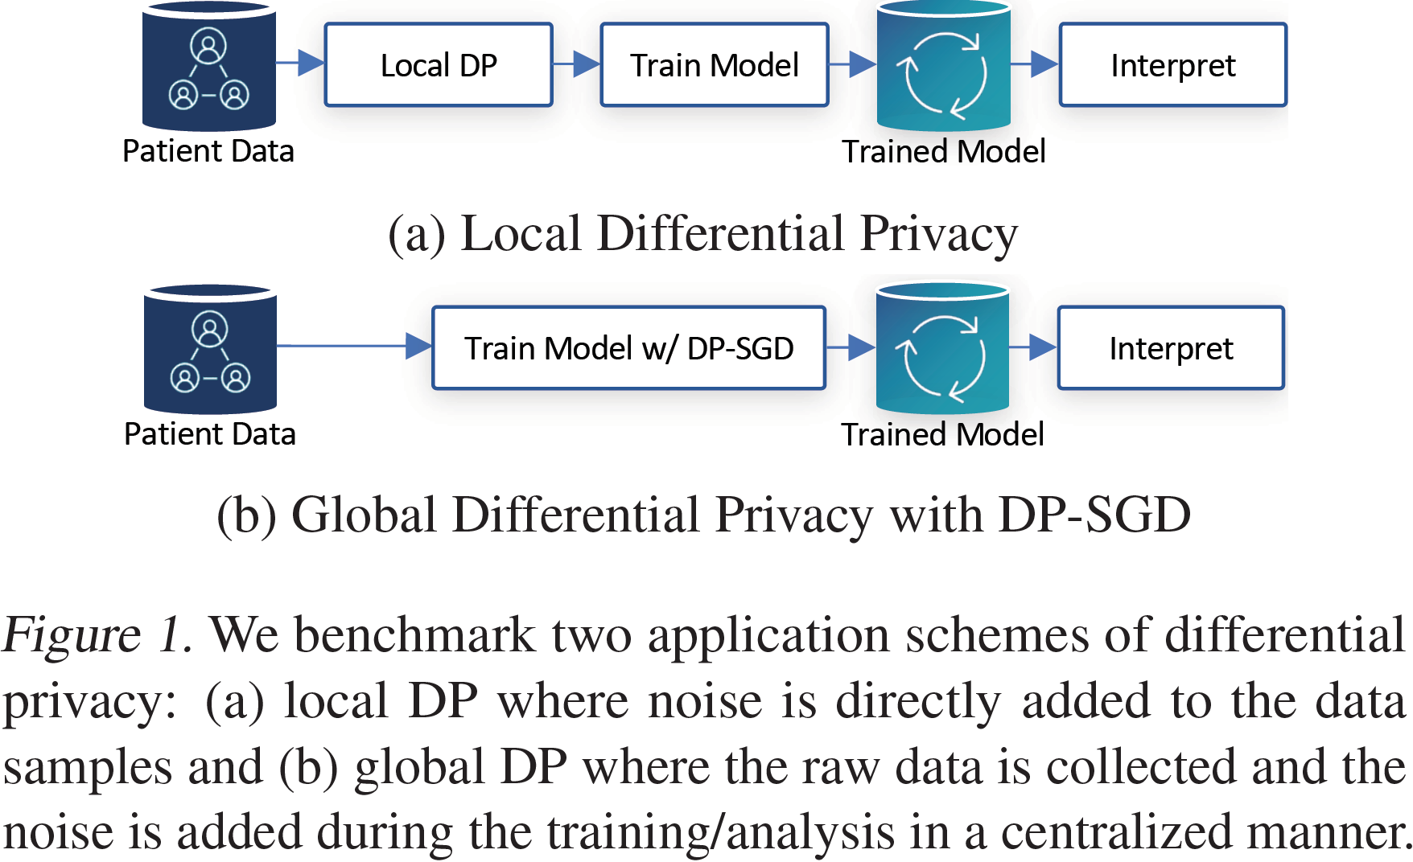
Introduction
Differential Privacy is an extensive tool that constitutes strong privacy guarantees for algorithms on a given dataset by describing the patterns of groups within the dataset while withholding information about individuals in the dataset.

Slide 34
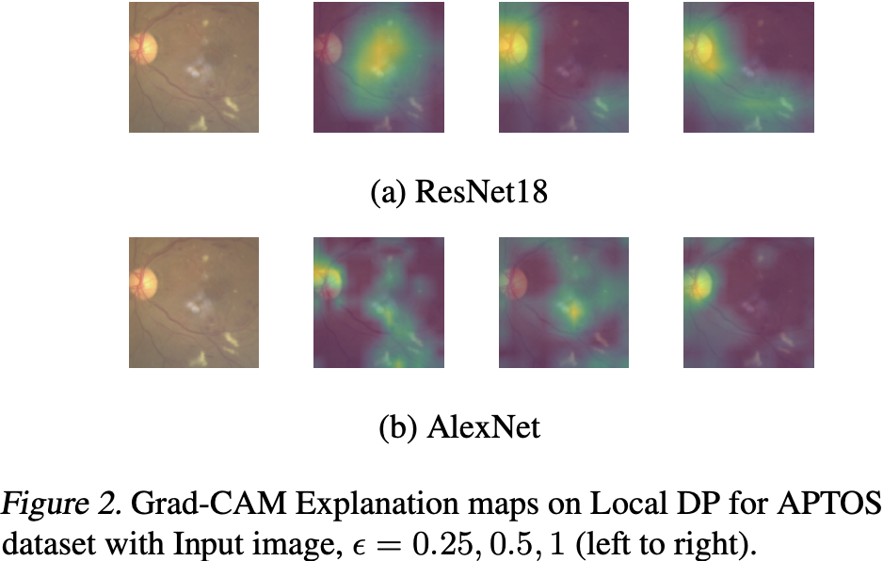
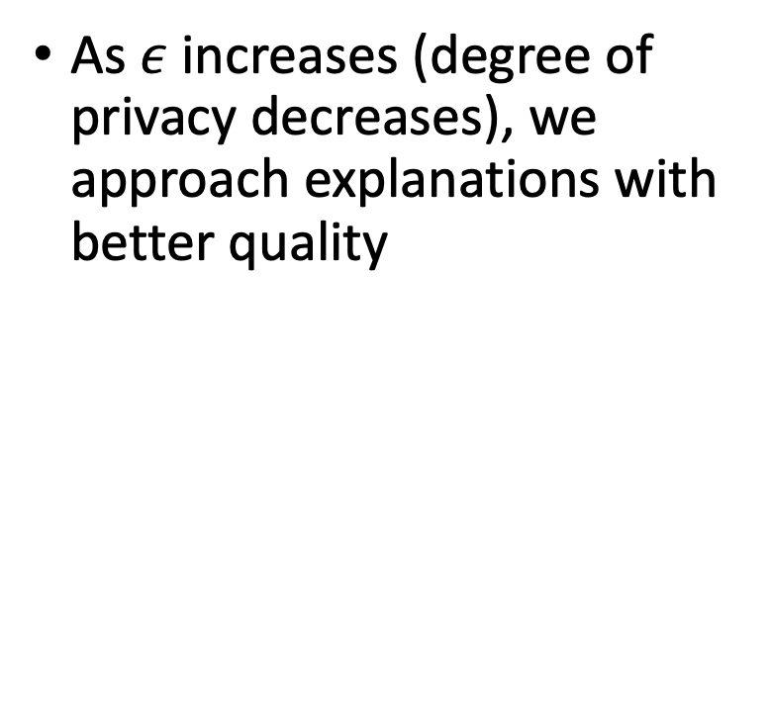
How the application of DP affects the quality of interpretations?
As $ε$ increases (degree of privacy decreases), we approach explanations with better quality

Slide 35
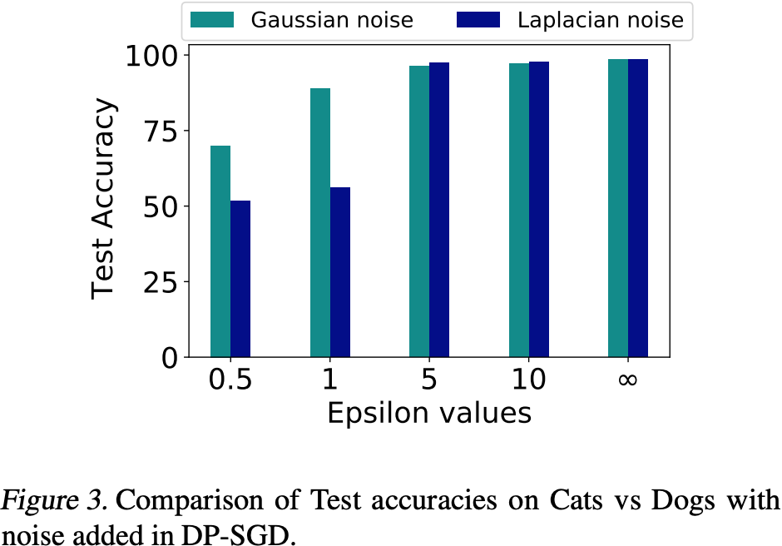
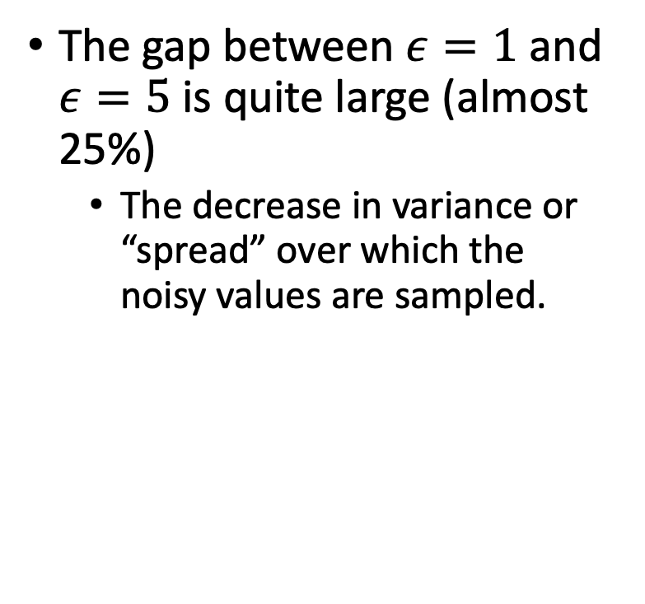
How the application of DP affects the quality of interpretations?
The gap between $ε=1$ and $ε=5$ is quite large (almost 25%)
The decrease in variance or “spread” over which the noisy values are sampled.

Slide 36
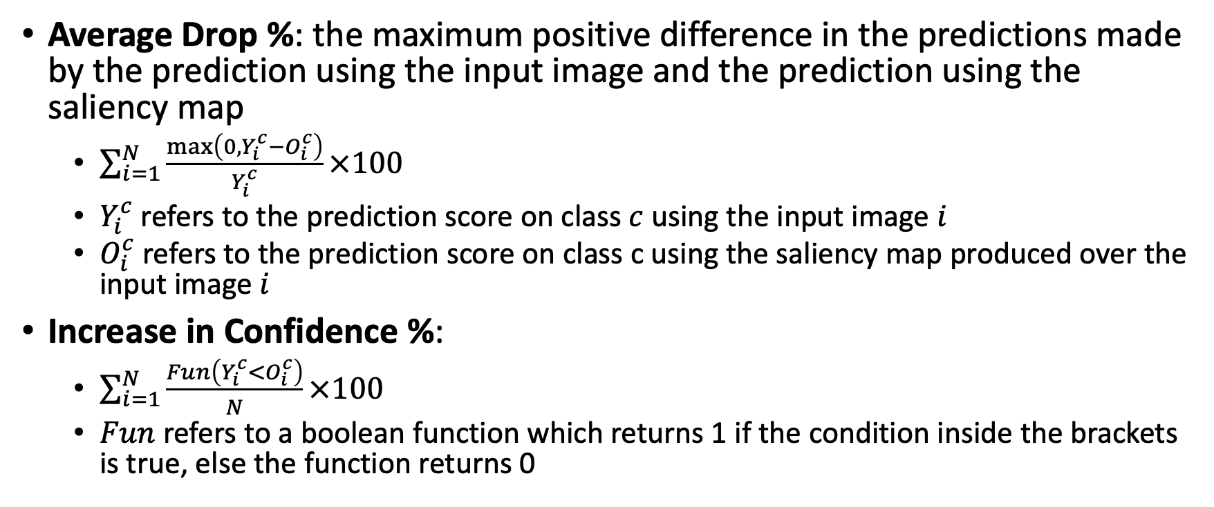
Metrics
Average Drop %: the maximum positive difference in the predictions made by the prediction using the input image and the prediction using the saliency map
$\sum_{i=1}^{N}{\frac{max\left(0, Y_{i}^{c}−O_{i}^{c}\right)}{Y_{i}^{c}}×100}$
$Y_{i}^{c}$ refers to the prediction score on class $c$ using the input image $i$
$O_{i}^{c}$ refers to the prediction score on class c using the saliency map produced over the input image $i$
Increase in Confidence %:
$\sum_{i=1}^{N}{\frac{Fun\left(Y_{i}^{c}<O_{i}^{c}\right)}{N}×100}$
$Fun$ refers to a boolean function which returns 1 if the condition inside the brackets is true, else the function returns 0

Slide 37
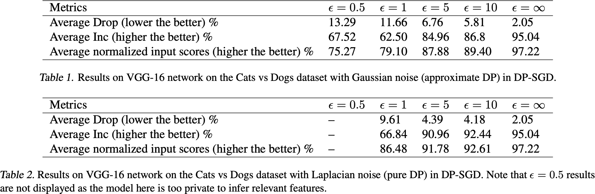

Slide 38
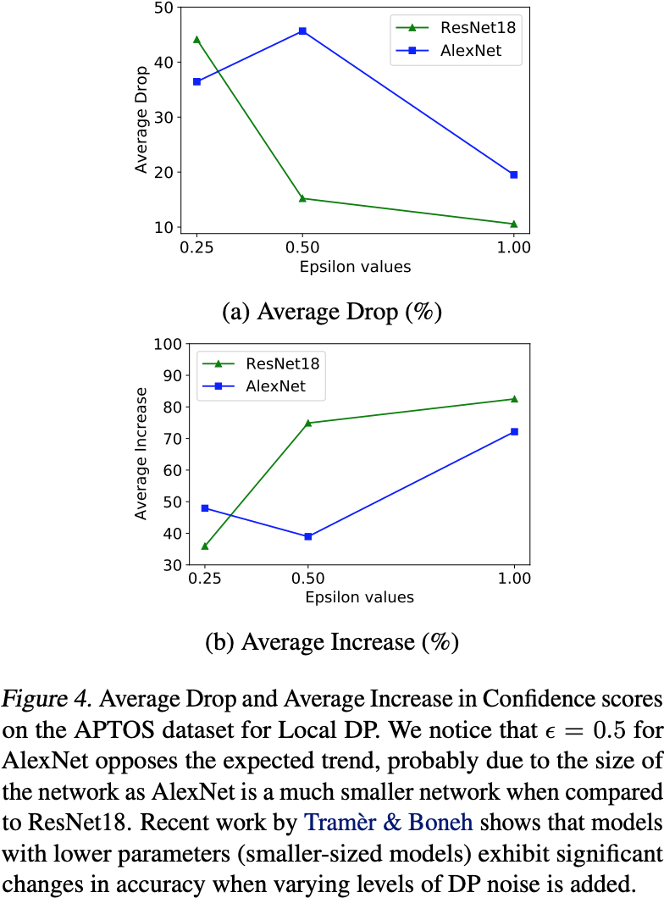
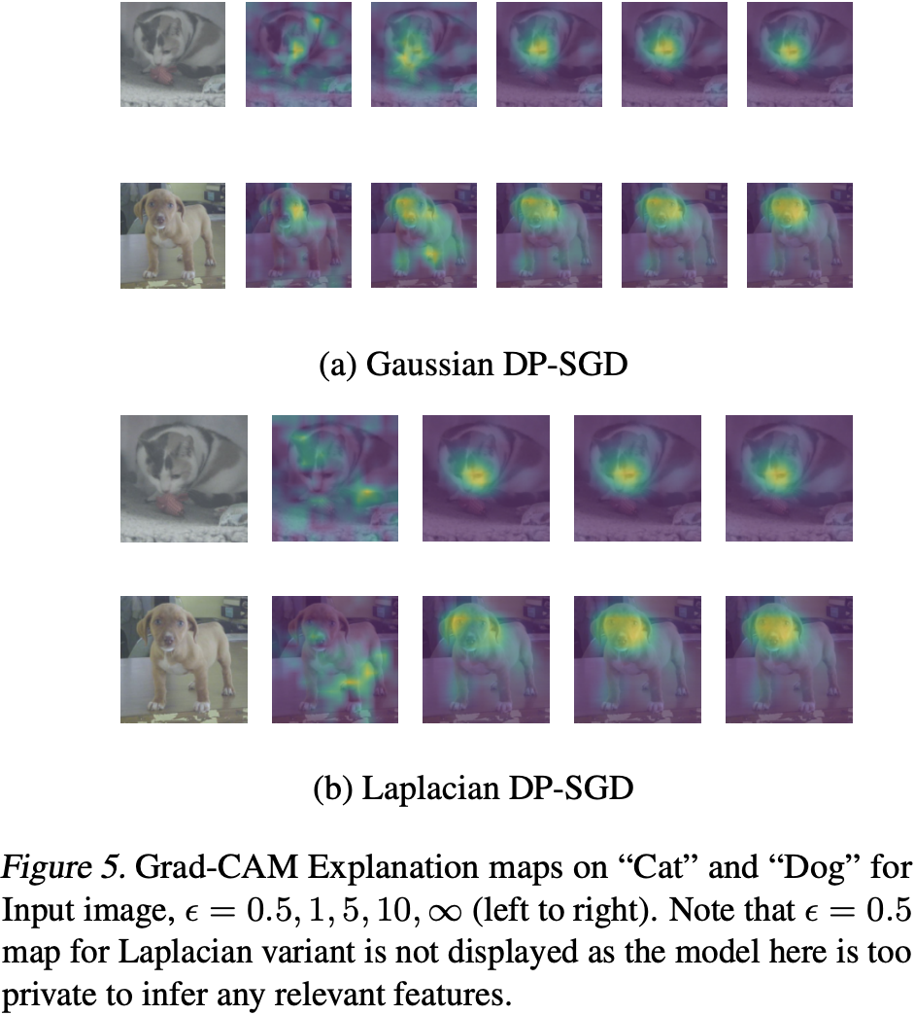

Slide 39
